Slide 1
FDA Food Recalls
Years 2012 - 2019

Slide 2
Food Product Recalls by FDA
Food Recalls of United States based on States
Food Recalls by Classification
Food Recalls Voluntary and Mandatory
Food Recalls by Firms and Recalls

Slide 3
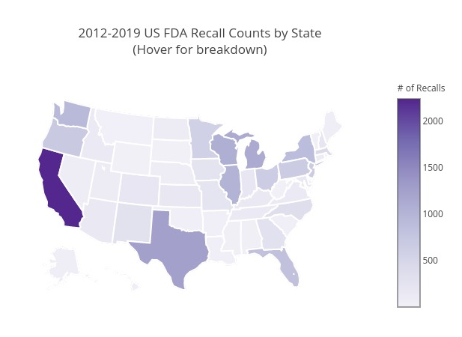
Food Recalls by the State
California ranks the highest in number of recalls.
California alone accounts for more than 12% of the recalls.
South Dakota is the lowest with only 2 recalls.

Slide 4
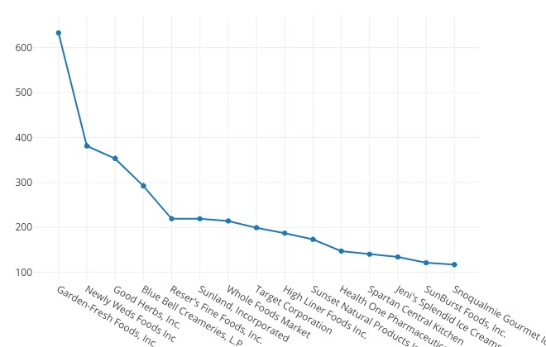
15 Firms with Highest Recalls
Garden-Fresh Foods has the highest recalls
15 companies account for more than 5% of the total recalls.
These 15 companies are from the pool of more than 10000 companies.

Slide 5
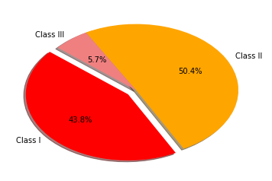
Food Recall by Categories
"Class I Recall" is the most urgent type of recall
"Class II Recall" is an intermediate threat level recall
"Class III Recall" is the least serious of all recall
Class II recalls are the highest in its category.

Slide 6
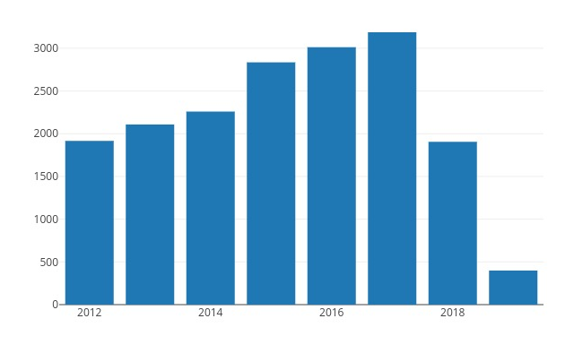
Food Recalls by Year
Year over year, there was an increase of over 50% in recalls from 2012 to 2017.
Recalls fell drastically, by over 40% between 2017 and 2018.
This drop can be related to decreased government spending and oversight.

